Slide 1
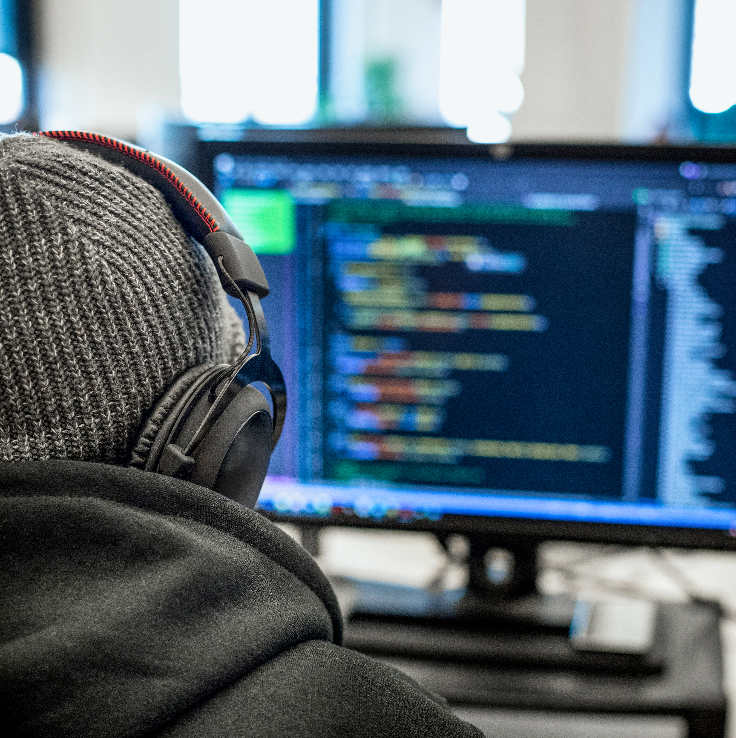
The Challenge Pitch
Tobias Urban, Cloud Solution Architect
Dennis Gassen, DevRel Team

Slide 2
1.000.000.000
Notes:
More than 1 billion individuals worldwide e live with some form of disability.

Slide 3
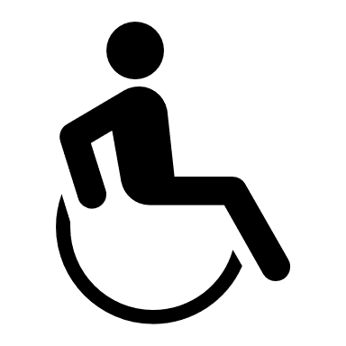

Visible Disabilities
vs.
Invisible Disabilities
~80% of people with a disability have a disability that is not immediately apparent

Slide 4
Examples of Invisible/Hidden Disabilities
ADHD
Anxiety disorders
Allergies
Arachnoiditis
Asperger Syndrome
Asthma
Autism
Bipolar disorder
Brain injuries
Charcot-Marie-Tooth disease
Chronic fatigue syndrome
Chronic pain
Circadian rhythm sleep disorders
Coeliac Disease
Crohn's disease
Depression
Diabetes
Epilepsy
Fetal Alcohol Spectrum Disorder (FASD)
Fibromyalgia
Food allergies
Fructose malabsorption
Hereditary Fructose Intolerance
Hyperhidrosis
Hypoglycemia
Inflammatory bowel disease
Interstitial cystitis
Irritable Bowel Syndrome
Lactose Intolerance
Lupus
Lyme Disease
Major depression
Metabolic syndrome
Myasthenia Gravis
Narcolepsy
Personality disorders
Primary immunodeficiency
Psychiatric disabilities
Reflex Sympathetic Dystrophy
Repetitive stress injuries
Rheumatoid arthritis
Schnitzler's Syndrome
Schizophrenia
Scleroderma
Sjögren's Syndrome
Trigeminal Neuralgia
Spinal Disorders
Temporomandibular joint disorder
Transverse Myelitis

Slide 5

The Challenge

Slide 6
Hack the Future – How can we use AI to improve the lives of people with a disability?
More than 1 billion individuals worldwide live with some form of disability. Disabilities have many various faces and are often invisible to others. Categories of disability types include various physical and mental impairments that can hamper or reduce a person's ability to carry out their day to day activities. Together let´s ease the burden of having an impairment.
Try to think about how technology might support people with some form of disability (according to United Nations CRPD):
Physical impairments (e.g. Diabetes, Multiple Sclerosis, Paralysis)
Sensory impairments (e.g. Vision disability, Hearing disability)
Mental impairments (e.g. Mood Disorders, Anxiety Disorders, Eating Disorders, Personality Disorders)
Intellectual/Learning impairments (e.g. Dyslexia, Down Syndrome, Autism)
Notes:
A lot of accessibiliyt features in our own products have started as a hackathon project…

Slide 7
Some Inspiration
How to empower people who are deaf or hard of hearing in group conversations such as conferences or roundtables?
How to efficiently collect and provide data on mobility and accessible places for people with disabilities?
How to increase the accessibility of websites through AI (e.g. automatically applying accessibility standards to websites; scanning new and revised content for accessibility issues daily; offering corrections to improve accessibility)?
How can an AI infused app help to motivate children manage Type 1 diabetes by gamifying the injection process?
How can AI support people with dyslexia? Think also about how to diagnose dyslexia.
How to empower people with down syndrome to better understand abstract concepts (including complex or long sentences) by translating information received into visuals such as symbols, muted videos or pictures.

Slide 8
Guidelines
Be curious, be creative and challenge yourself
Objective: Your solution should help people with impairments
Use whatever technology, frameworks and languages you prefer
We´d love to support you using Microsoft Azure, but this is no requirement
We will provide free Azure Credits for all teams
We will offer additional hardware for your projects (Tobii Eye Tracker, Cortana Speaker, Kinect, Raspberry PI etc.)
We have a Xbox ☺

Slide 9
Azure Cognitive Services
Infuse AI into your apps with APIs for:
I want to use pre-built models
Which Azure AI service should I use?
Vision
Speech
Language
Web Search
Decision
I want to build my own models
Azure Machine Learning services
Yes
Do I want to use Python?
No
Yes
Do I want to use my own dev environment?
No
Yes
Familiar with ML algorithms?
No
Azure ML
Python SDK
Install the SDK in any Python environment (Jupyter Notebooks, VS Code etc.) and use it with all popular ML frameworks.
Azure ML
Notebook VMs
Cloud Hosted VMs with Jupyter Notebooks. Preconfigured with the Azure Python SDK, popular frameworks, and smooth integration with Azure compute.
Azure ML
Visual interface
Prep data, train, deploy, manage and track machine learning models with a drag & drop interface.
Azure ML
Automated ML UX
Automatically train and tune a model for your dataset and target metric with a UX with form-like simplicity.
Automated ML tests multiple algorithms and hyperparameters in parallel to generate the most suitable model.
Notes:
Native Editing of Jupyter Notebooks in VS Code

Slide 10
Prices for the Microsoft Challenge
Windows Mixed Reality Headset with Controllers
4-FLY Drones with Camera
Mini Drones
Instant Polaroid Cams
SWAG (Sticker, various Shirts, Chargers, Water Bottles, Bags, more Stickers…)

Slide 11
Let´s hack
Notes:
More than 1 billion individuals worldwide e live with some form of disability.

